Slide 1


Random Walks on Huge Graphs at Cache Efficiency
2022.12.15 叶楚玥

Slide 2
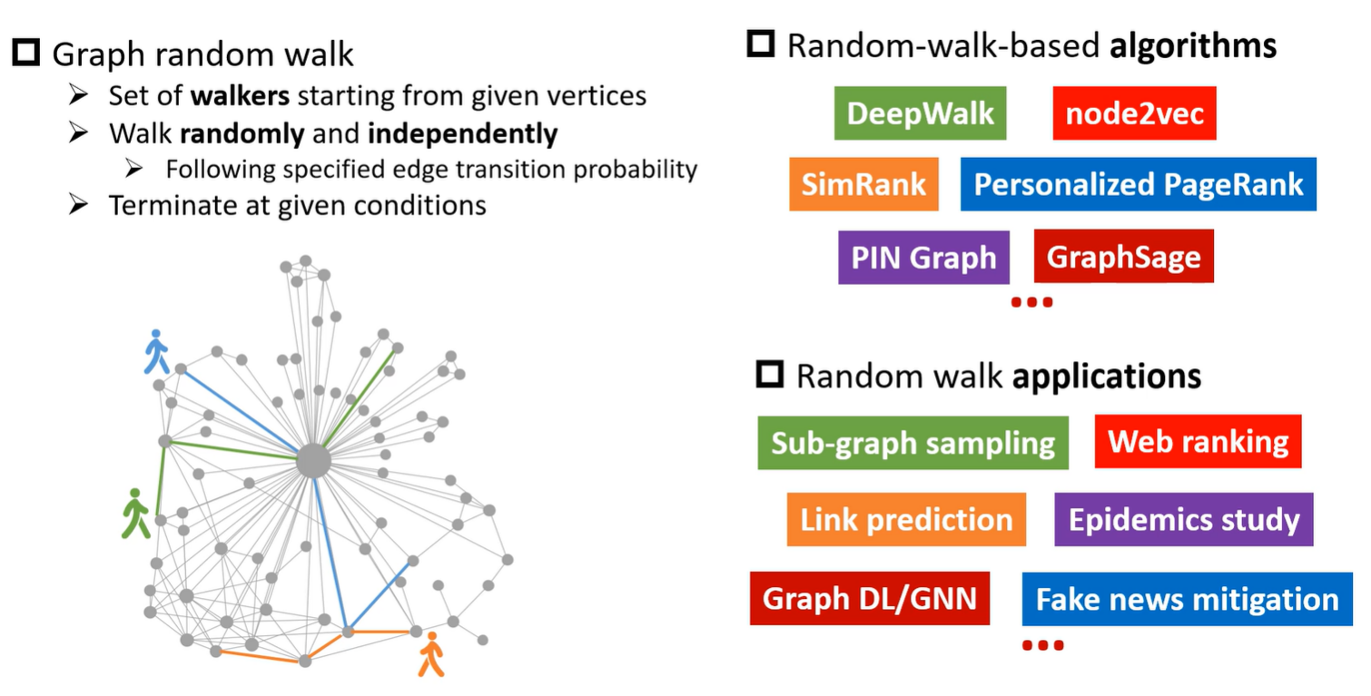
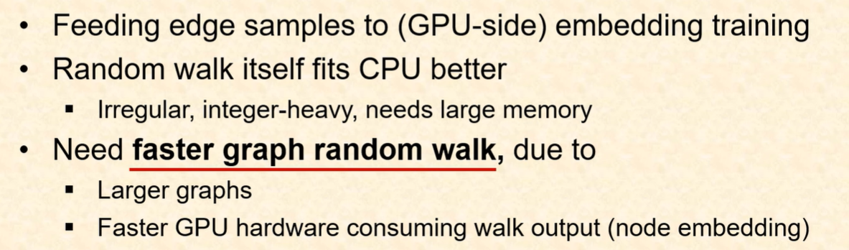
Graph Random Walk

Slide 3
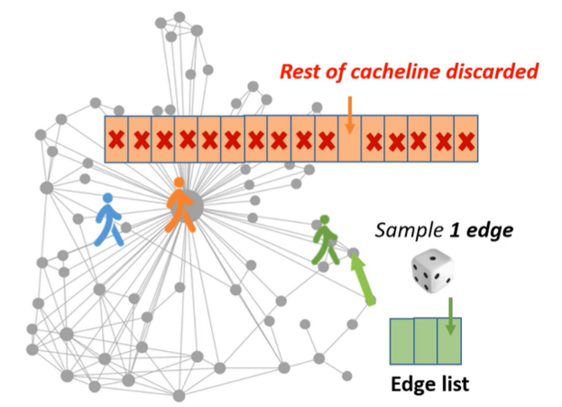
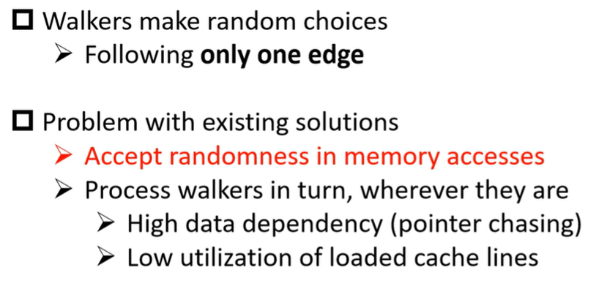
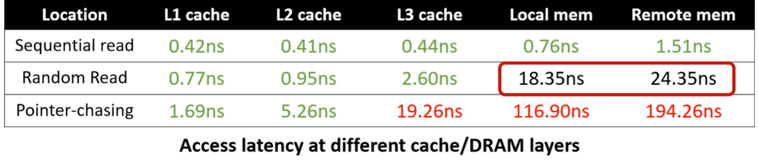
Challenge: Slow Random Memory Accesses

Slide 4
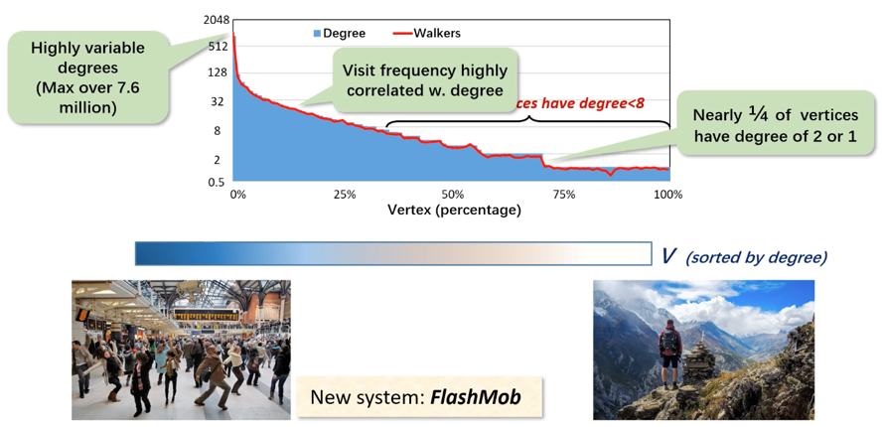
Key Insight: Vertices Not Equal

Slide 5
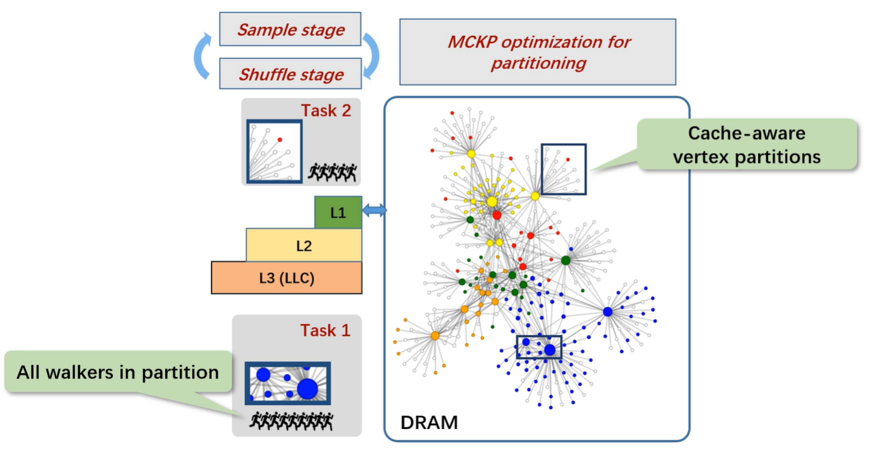
FlashMob: Cache-speed Graph Random Walk

Slide 6
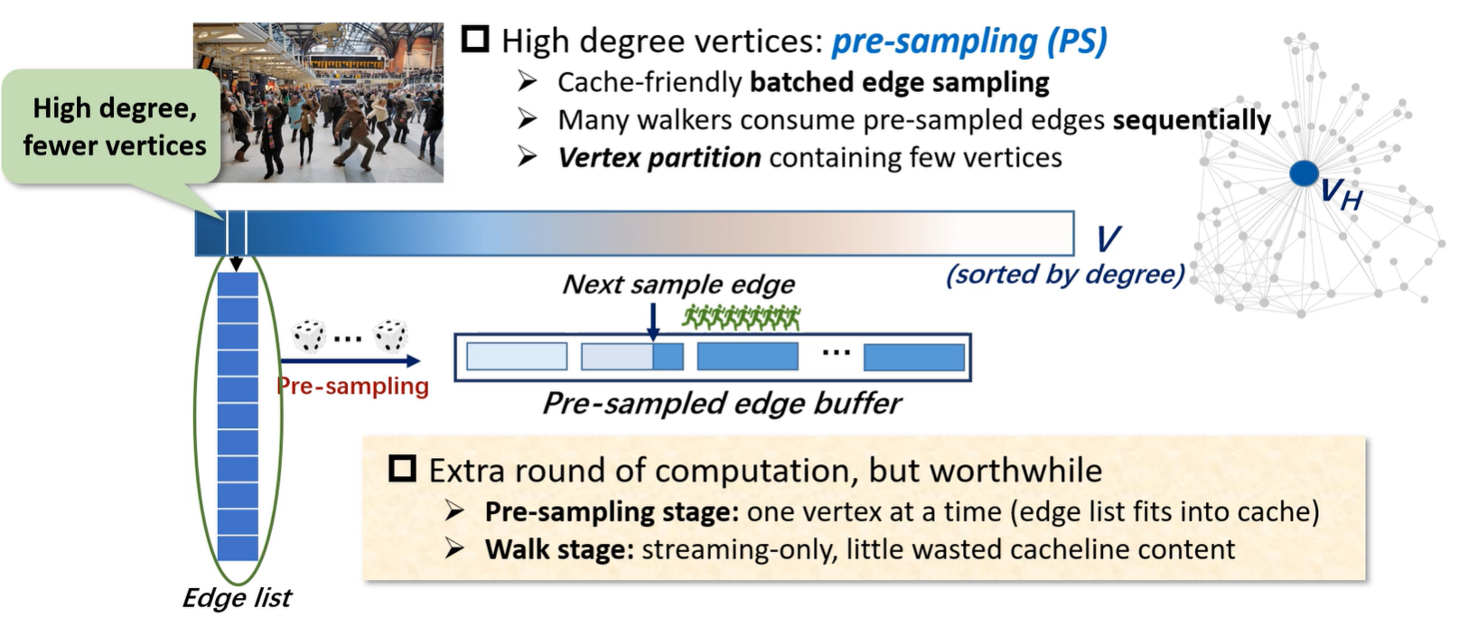
FlashMob: Cache-speed Graph Random Walk (I)

Slide 7
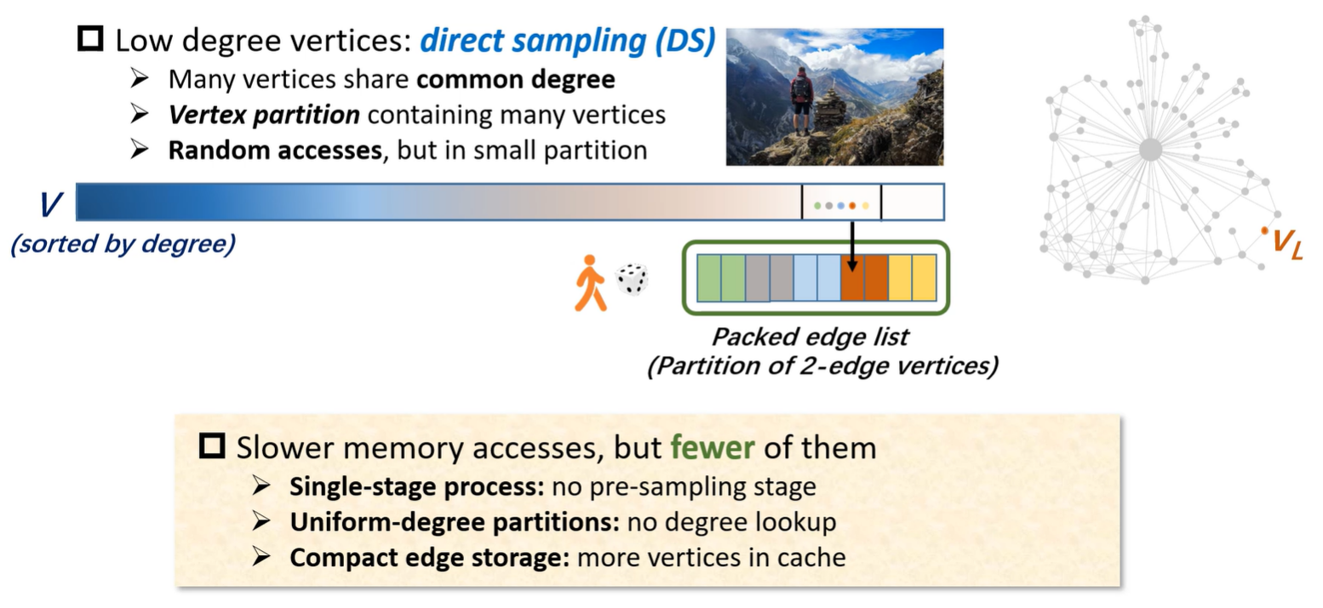
FlashMob: Cache-speed Graph Random Walk (II)

Slide 8
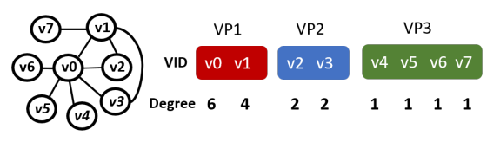
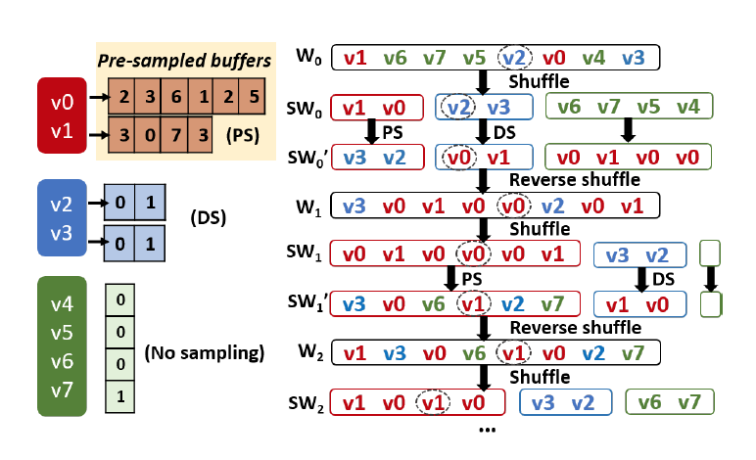
System Design

Slide 9
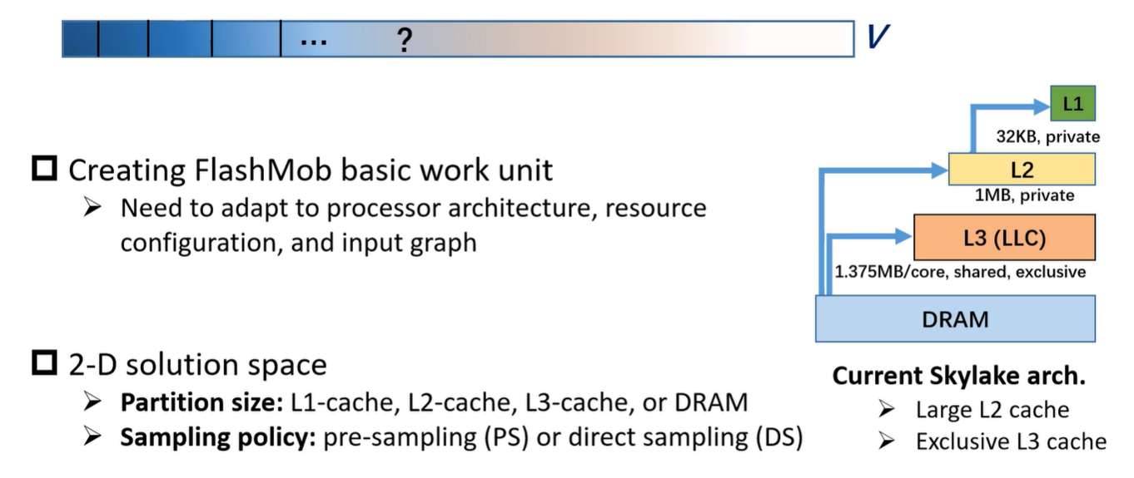
Problem: How to Cut Out Vertex Partitions?

Slide 10
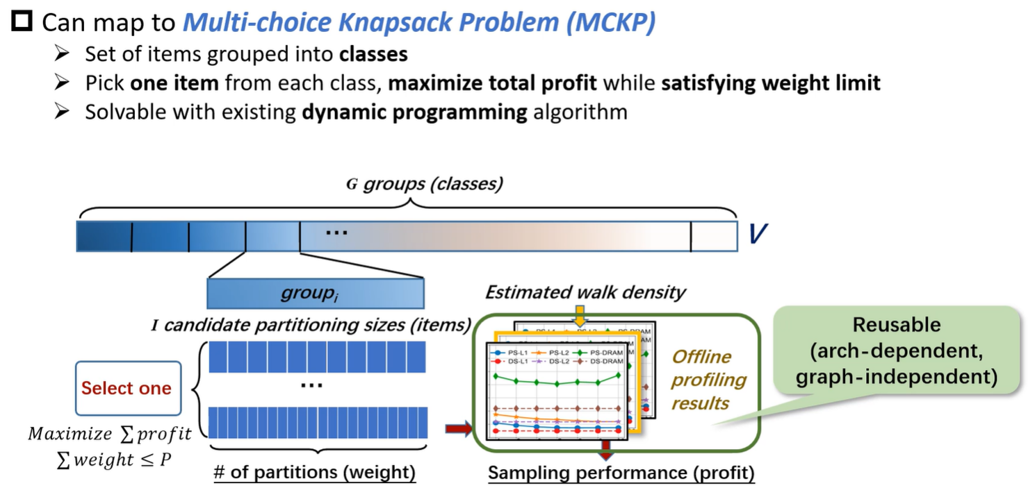
Automatic, Adaptive Vertex Partitioning

Slide 11
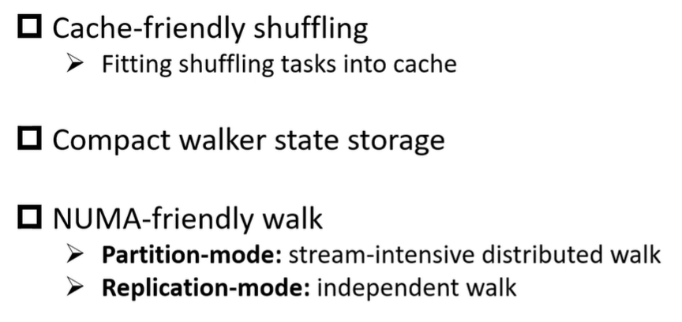
Other Optimizations

Slide 12
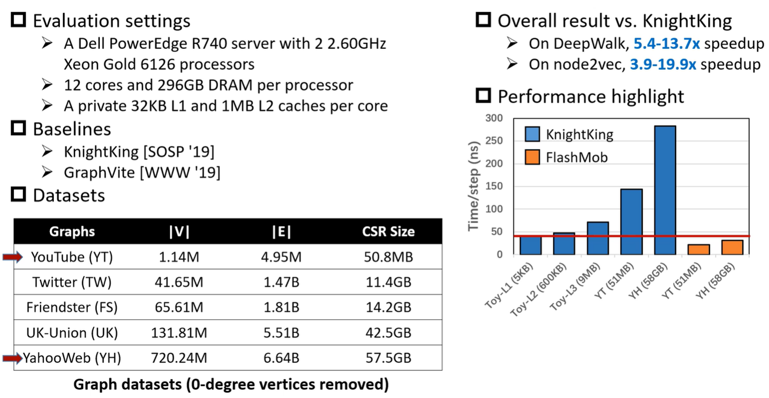
Evaluation

Slide 13
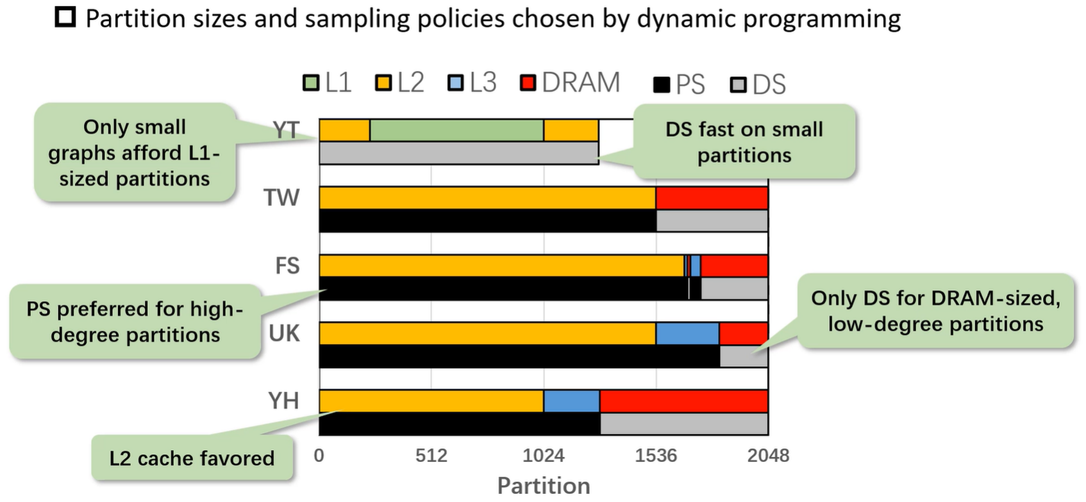
Effectiveness of MCKP Auto Partitioning

Slide 14
THANKS!
Random Walks on Huge Graphs at Cache Efficiency
汇报人： 叶楚玥

